Slide 1

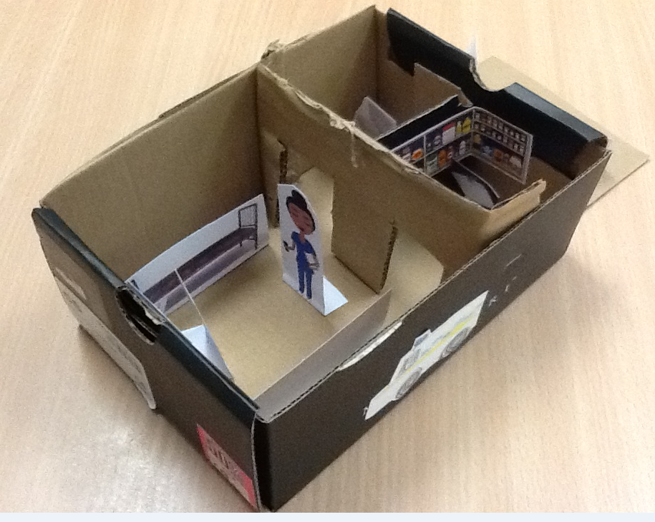
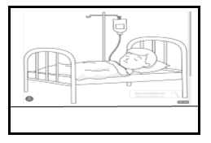
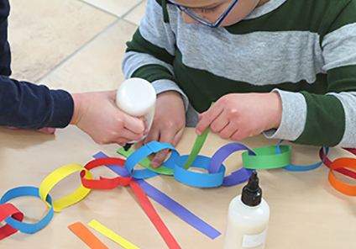
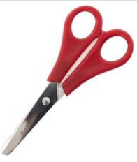
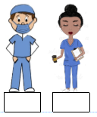
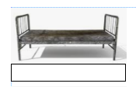
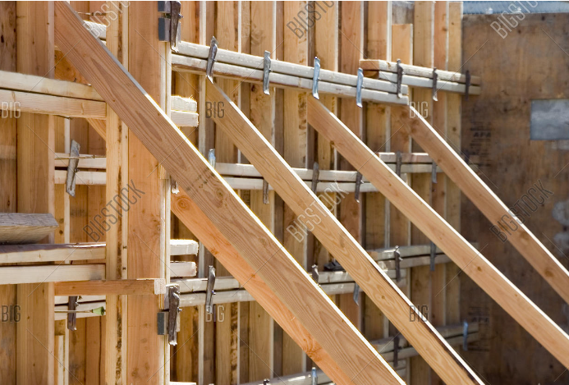
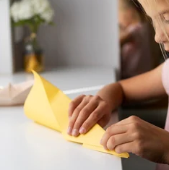


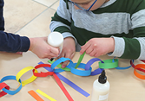


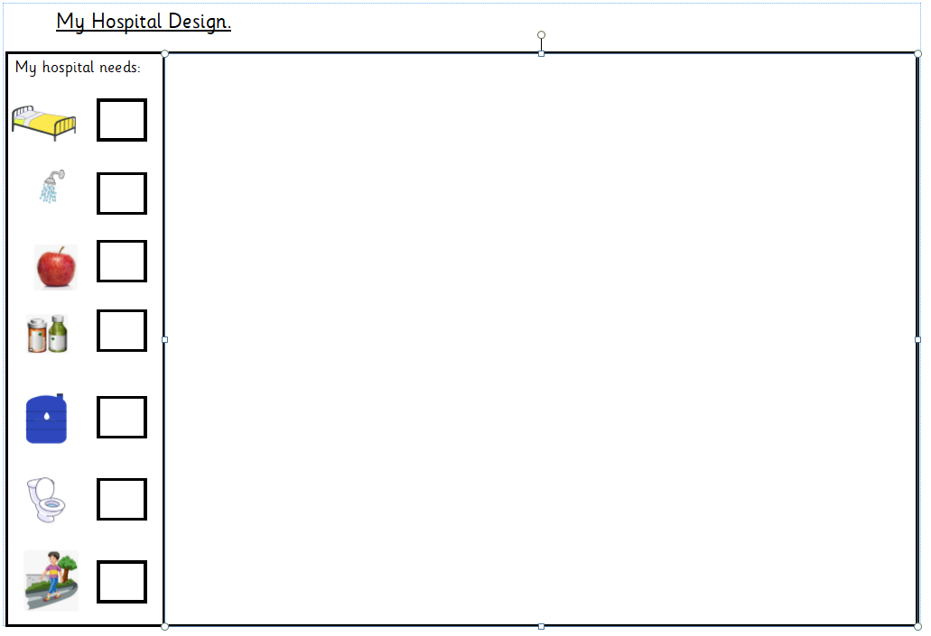
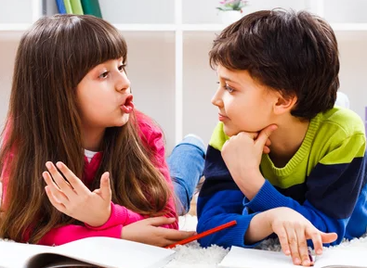
What I already know
I know how to use scissors and other equipment to joining and roll.
Throughout year R and I have used my joining skills
Year 1 - Build a hospital
Key Vocabulary
Flap
Joining
Support
Stable
Practice your skills
Remember not to cut off
the bottom.
Cutting
folding
You will have a shoe box which you would have put your objects into.
Can you talk about what and why you have put these in?
Design
What shape are you going to make?
Think about the markings you would like?
Evaluate
Can you tell me what you like about your model, how could you change it?

