Slide 1
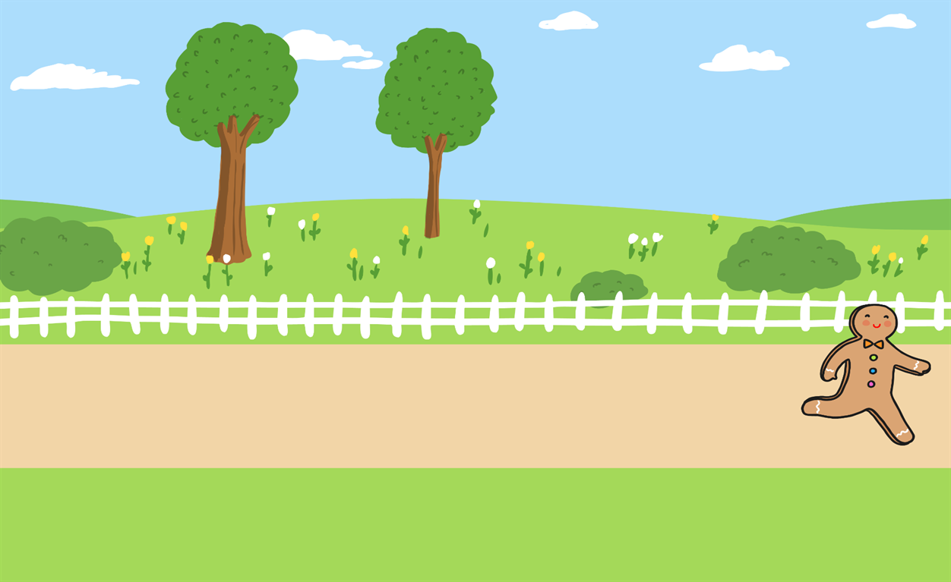
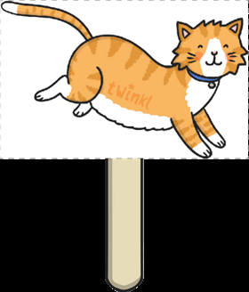
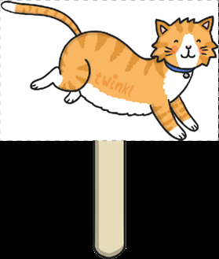
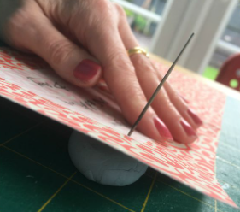
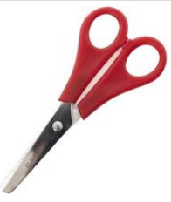
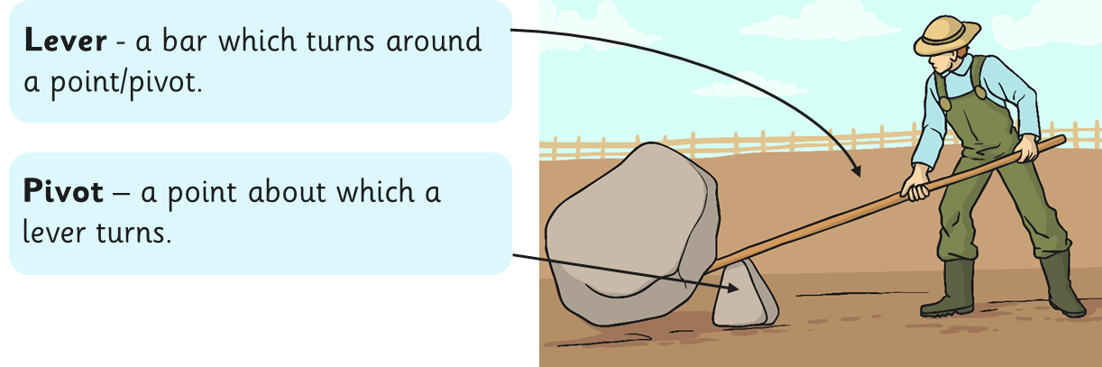
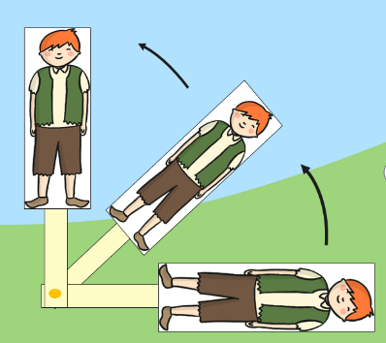
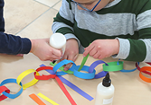
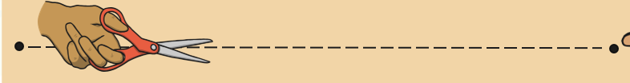
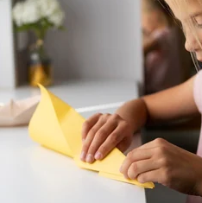
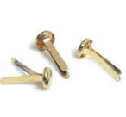

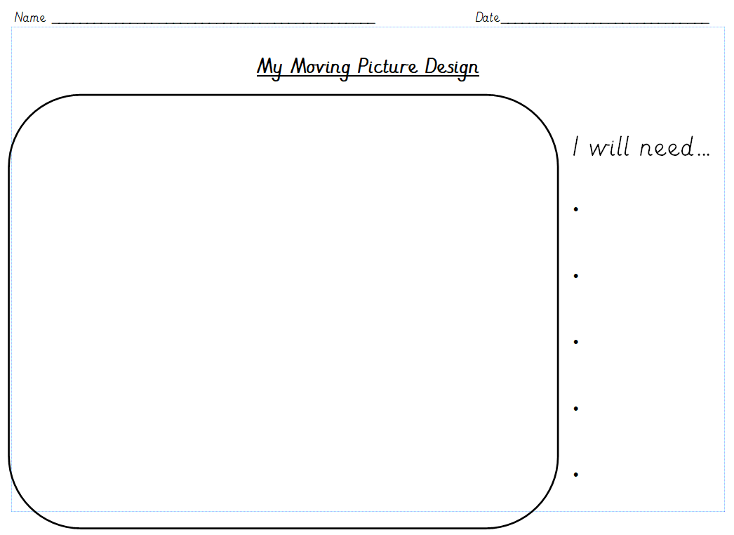
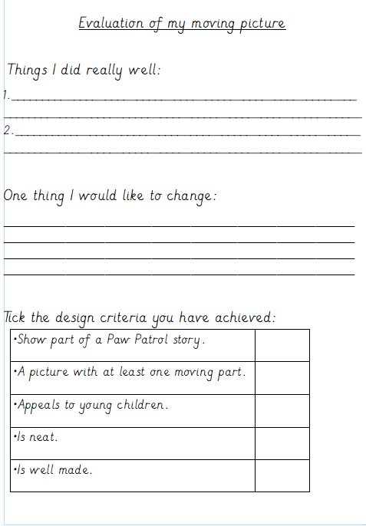
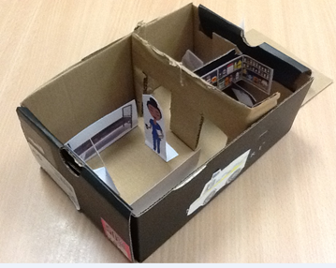
Year 1 - Moving picture
Key Vocabulary
Slider
Pivot
Lever
What I already know
I know how to use scissors and other equipment to joining and roll.
Throughout year R and I have used my joining skills
During the Mary Seacole topic I designed a hospital
Practice your skills
To make a hole - Put the blu tak under the paper, use a pencil to push through.
Cutting- Only cut between the dots.
Folding Split pins
Design
What slider are you going to make?
Think the equipment you will need.
Evaluate
Can you tell me what you like about your model, how could you change it?

