Slide 1
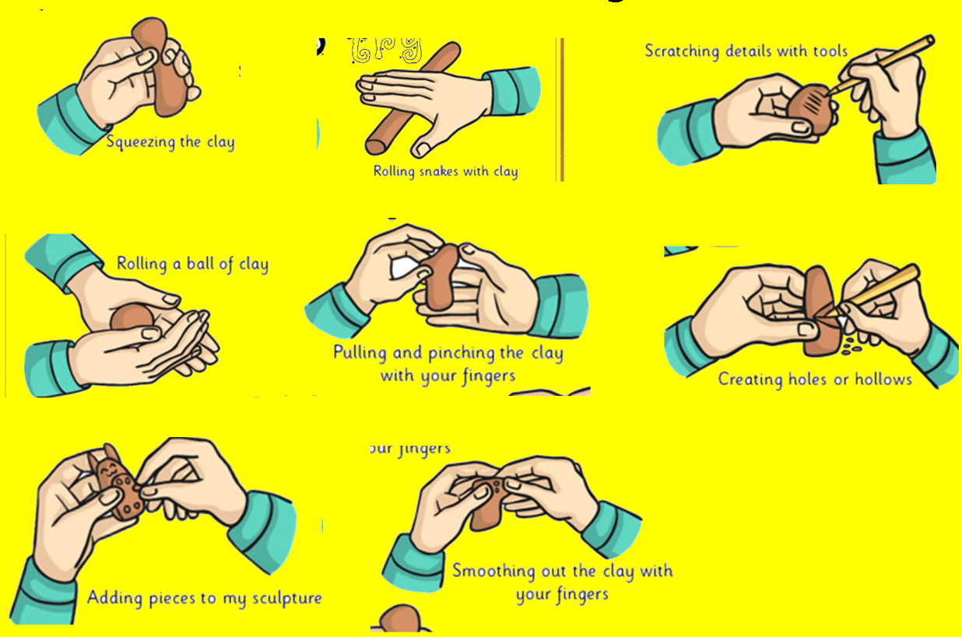
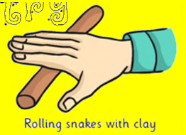
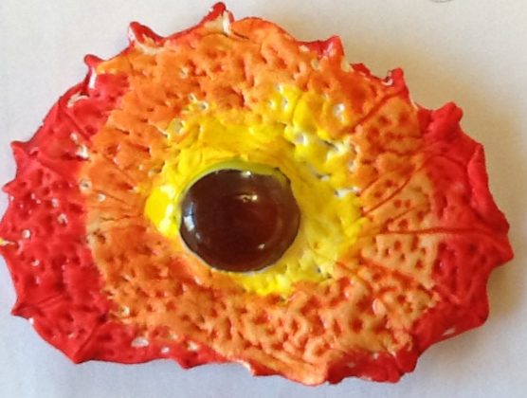
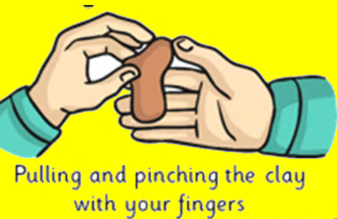
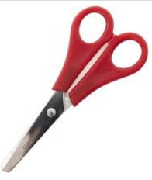
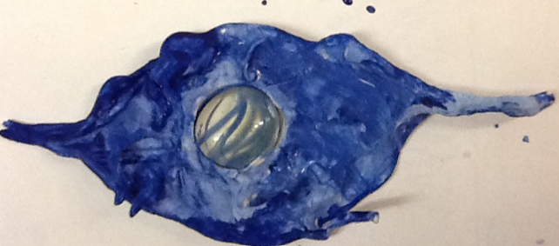
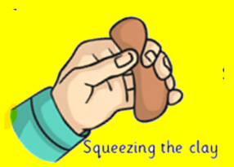
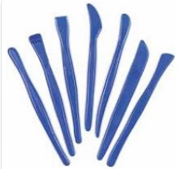
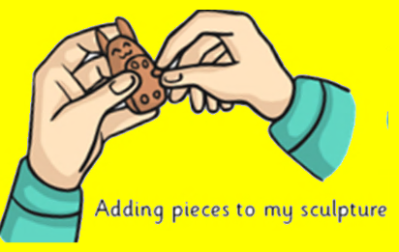
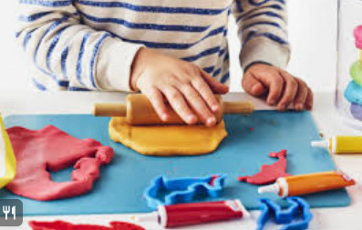
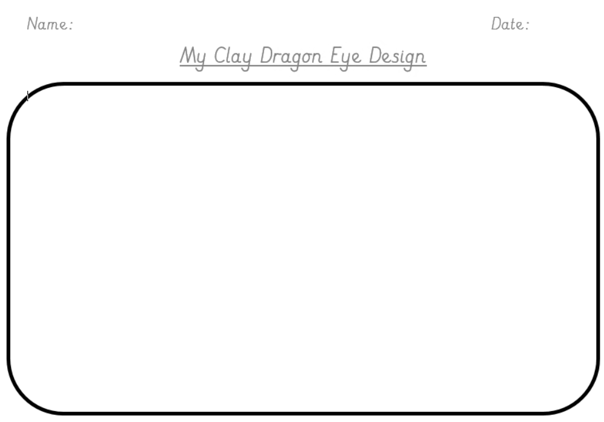
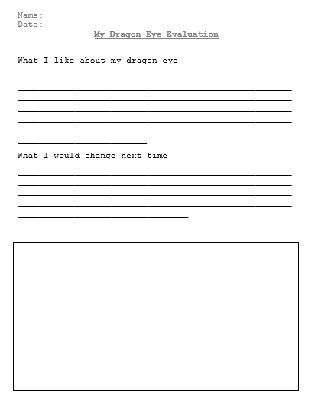

What I already know
I know how to use scissors and other equipment to joining and roll.
Throughout year R and Year 1 I have used playdoh to create my own models.
Year 2 - Dragon’s eye
Key Vocabulary
Roll
pinch,
squash
Squeeze
sections
attach
Practice your skills
Roll it into a ball
Smooth out the cracks
What tools can you use to add some markings.
You will have an eye using your hot or cold colours.
Can you remember what colours are for hot and which are for cold?
Design
What shape are you going to make?
Think about the markings you would like?
Evaluate
Can you tell me what you like about your model, how could you change it?

