Slide 1
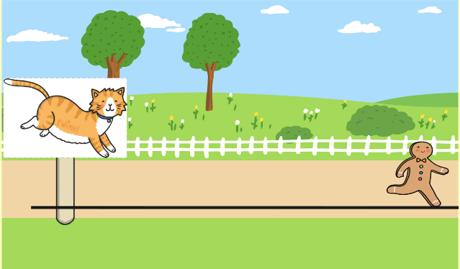
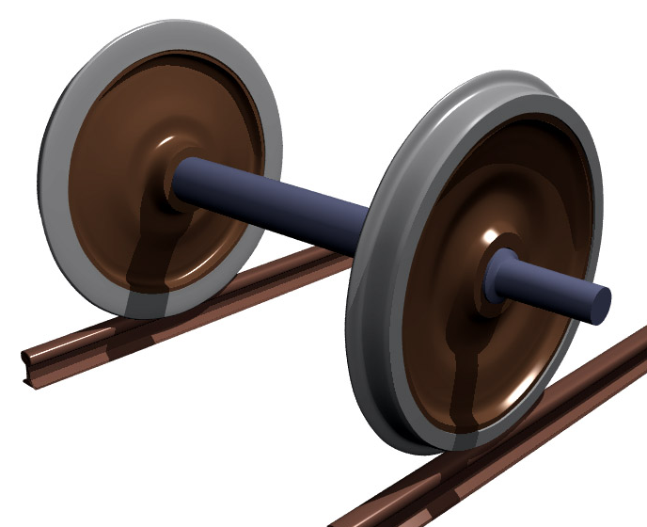
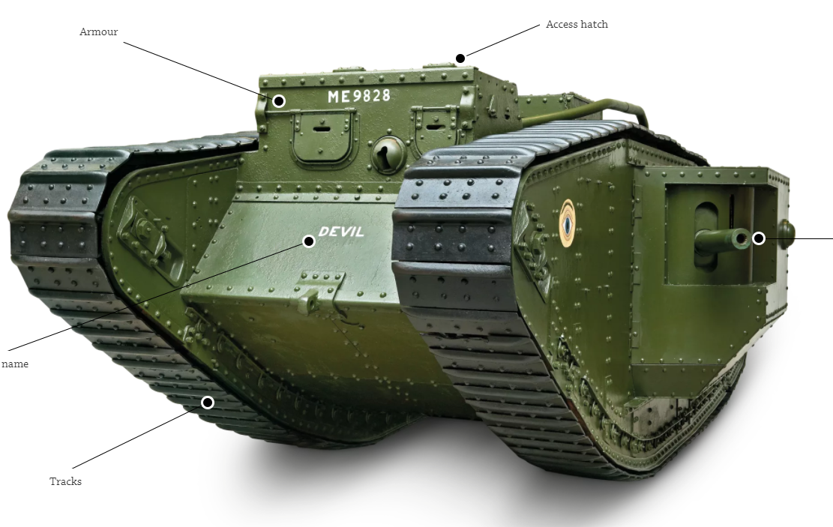
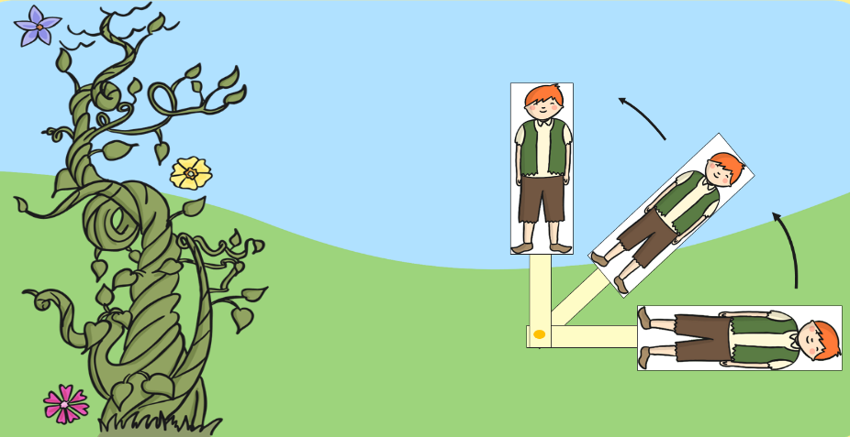
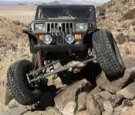
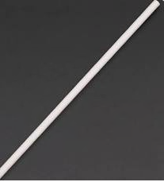
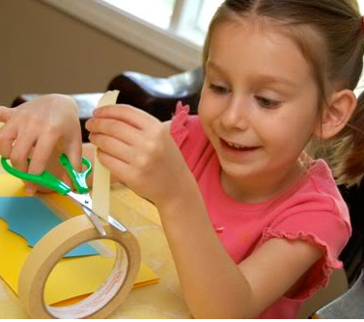
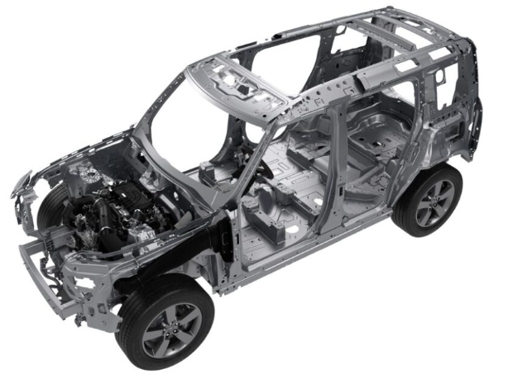
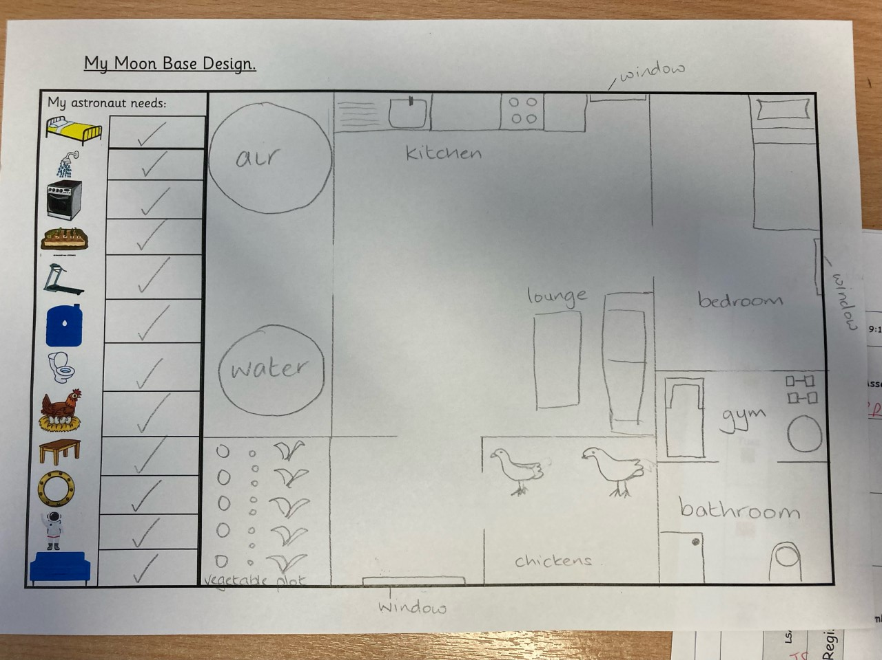

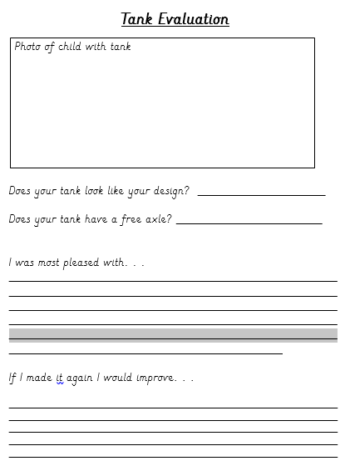
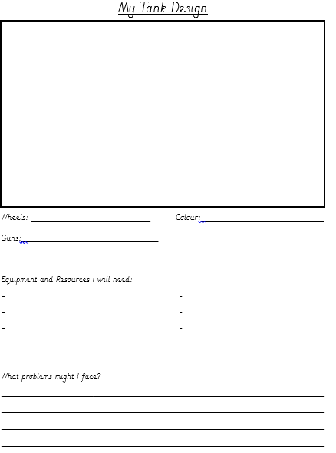

What I already know
Slider mechanism
Lever mechanism
How to cut masking tape
Designing a plan
Year 2 - Moving Vehicle
Key Vocabulary
Free axle
These move the wheels
Fixed axle
The axles that are fixed to the vehicle
Chassis
The framework of a vehicle
Evaluate
Looking at your work, how could you make it better next time
Looking at how tanks are made
What does a tank need?
Remember when making your free axle don’t make the hole too big.
What do you think will happen if they are too big?
Use your pencil
To make the hole
In your disc.
Check the size of your straw, Is it the right size for your box.
My tank will need an axle
Can you add your own symbol
Has your tank got a gun?
A tank needs to be strong
They travel through water and muddy fields
Attach your free axle to your chassis (box)
Use tape to do this. Make sure the tape is long enough to go over the straw. It has to be tight.
What went well?
What could I change
What do you want it to look like?
What resources do you need?

